Slide 1
Time Complexity
AKA why it takes a second to friend someone on Facebook or get directions on Google Maps vs a couple of days or months (no exaggeration)

Slide 2
What is Time Complexity
It describes the run-time of an algorithm and how the number of operations performed grows with the input.

Slide 3
What is Time Complexity
It describes the run-time of an algorithm and how the number of operations performed grows with the input.
If iterating an array of size 10 takes 1 unit of time
Iterating an array of size 20 DOES NOT NECESSARILY take 2 units of time

Slide 4
Big O notation
Used to express the time complexity as a function of the input size where n is the input size.
O(1) - Constant time
O(n) – Linear
O(n²) – 2 nested for loops
O(n log n) - Most sorting algorithms

Slide 5
Big O notation
Used to express the time complexity as a function of the input size.
Typically represents the # of operations being performed.
O(1) - Constant time
O(n) – Linear
O(n²) – 2 nested for loops
O(n log n) - Most sorting algorithms

Slide 6
Operations
Just an action/statement
Inputting
Outputting
Storing a value
Arithmetic
Comparisons (if statements)
Etc…
O(1) time complexity
AKA Constant time

Slide 7
Big O notation
Used to express the time complexity/# of operations as a function of the input size.
O(1) - Constant time
O(n) – Linear
O(n²) – 2 nested for loops
O(n log n) - Most sorting algorithms
for number from 0 to 10{
variable = number
}

Slide 8
Big O notation
Used to express the time complexity/# of operations as a function of the input size.
O(1) - Constant time
O(n) – Linear
O(n²) – 2 nested for loops
O(n log n) - Most sorting algorithms
for number from 0 to 1000{
// do some stuff
}

Slide 9
Big O notation
Used to express the time complexity/# of operations as a function of the input size.
O(1) - Constant time
O(n) – Linear
O(n²) – 2 nested for loops
O(n log n) - Most sorting algorithms
n = getInputFromUser
for number from 0 to n{
// do some stuff
}

Slide 10
Big O notation
Used to express the time complexity/# of operations as a function of the input size.
O(1) - Constant time
O(n) – Linear
O(n²) – 2 nested for loops
O(n log n) - Most sorting algorithms
n = getInputFromUser
for number from 0 to n{
// do some stuff
}
n operations.
# of operations increases linearly as n increases.

Slide 11
Big O notation
Used to express the time complexity/# of operations as a function of the input size.
O(1) - Constant time
O(n) – Linear
O(n²) – 2 nested for loops
O(n log n) - Most sorting algorithms
n = getInputFromUser
for number from 0 to n{
for number from 0 to n{
// do some stuff
}
}

Slide 12
Big O notation
Used to express the time complexity/# of operations as a function of the input size.
n = getInputFromUser
for number from 0 to n{
for number from 0 to n{
// do some stuff
}
}
O(1) - Constant time
O(n) – Linear
O(n²) – 2 nested for loops
O(n log n) - Most sorting algorithms
n² operations.
# of operations increases quadratically as n increases.
n | 3 | 5 | 100 | 1000
operations | 9 | 25 | 10,000 | 1,000,000

Slide 13
Important Rule
We only consider the highest order term for time complexity.
n = getInputFromUser
for number from 0 to n{
for number from 0 to n{
// do some stuff
}
}
for number from 0 to n{
//Some more stuff
}

Slide 14
Important Rule
We only consider the highest order term for time complexity.
The program has an O(n²) time
complexity.
n = getInputFromUser
for number from 0 to n{
for number from 0 to n{
// do some stuff
}
}
for number from 0 to n{
//Some more stuff
}
n | 3 | 10 | 100 | 1,000 | 100,000
n² | 9 | 100 | 10,000 | 1,000,000 | 10,000,000,000
n² + n | 12 | 110 | 10,100 | 1,001,000 | 10,000,100,000

Slide 15
Why it Matters for Competitions
Most competition systems can only do 10⁸ operations per second.

Slide 16
Why it Matters for Competitions
Most competition systems can only do 10⁸ operations per second.
KEEP AN EYE ON INPUT CONSTRAINTS!
They typically indicate or give a hint as to how efficient your solution should be.

Slide 17
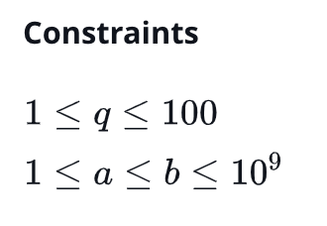
Examples
Remember Sherlock and Squares from last week?
O(n) will not pass → 10⁹ operations.

Slide 18
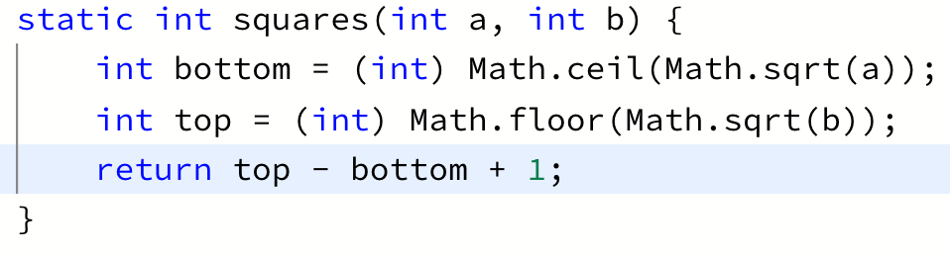
Examples
Remember Sherlock and Squares from last week?
We solved it in O(1)

Slide 19
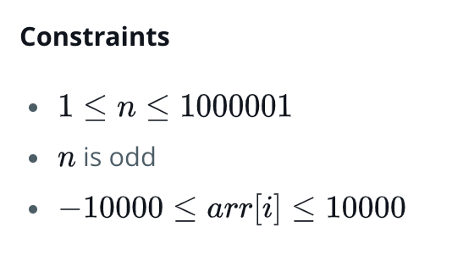
Examples
Remember Find the Median from last week?
Anything bigger than O(n log n) will not pass.
n | 3 | 10 | 100 | 1,000 | 1,000,001
n | 3 | 10 | 1000 | 1,000 | 1,000,001
n log n | 3 | 30 | 700 | 10,000 | ~ 20,000,000
n² | 9 | 100 | 10,000 | 1,000,000 | 1,000,000,000,000

Slide 20
Examples
Remember Find the Median from last week?
Sorting – O(n log n) solution
Frequency Table – O(n) solution
n | 3 | 10 | 100 | 1,000 | 1,000,001
n | 3 | 10 | 1000 | 1,000 | 1,000,001
n log n | 3 | 30 | 700 | 10,000 | ~ 20,000,000
n² | 9 | 100 | 10,000 | 1,000,000 | 1,000,000,000,000

Slide 21
Real World Examples
There are more than 3 million roads in the world Imagine if Google tried every single combination of roads to find the best route

Slide 22
Real World Examples
There are more than 3 million roads in the world Imagine if Google tried every single combination of roads to find the best route
2^{3,000,000}combinations of roads
For each of those combinations → n! ways to order them.
SCARILY BIG

Slide 23
Real World Examples
LinkedIn
When you connect with someone, they show you that person’s connections.
Imagine if to do that, LinkedIn iterated over every single user of LinkedIn, checked if they were that person’s connection, then showed those connections to you.

Slide 24
Practice!
n = getInputFromUser
for number from 0 to n{
for number from 0 to n{
// do some stuff
}
}
for number from 0 to n{
//Some more stuff
}

Slide 25
Practice!
n = getInputFromUser
for number from 0 to n{
for number2 from number to n{
// do some stuff
}
}

Slide 26
Practice!
n = getInputFromUser
for number from 0 to n{
for number2 from number to n{
// do some stuff
}
}
Still O(n²) because even though technically it is (n * (n – 1) ) / 2, it grows quadratically

Slide 27
Practice!
n = getInputFromUser
for number from 0 to n{
//array’s size is n
array = readArray()
}
Still O(n²) because we loop n times and read in an array of size n → n * n = n²

Slide 28
Practice!
n = getInputFromUser
for number from 0 to n{
//array’s size is n
array = readArray()
sort(array)
}
n = getInputFromUser
Loop n times{
read n elements
sort n log n operations
}
This one is O(n² log n)
Loop n times
Inside the loop, n log n > n
So: n * n log n = n² log n !

Slide 29
Moral of the Story
Keep an eye out on the input constraints
When solving a problem and you think you have a solution, check that you won’t get TLE (Time Limit Exceeded)
YOU DON’T NEED THE MOST EFFICIENT SOLUTION TO SOLVE A PROBLEM.
The median problem could be solved in 2 lines of code with sorting vs a lot more with a frequency table.

